Slide 1

Client side validation
By Uchit Shrestha and Nishan Shrestha

Slide 2
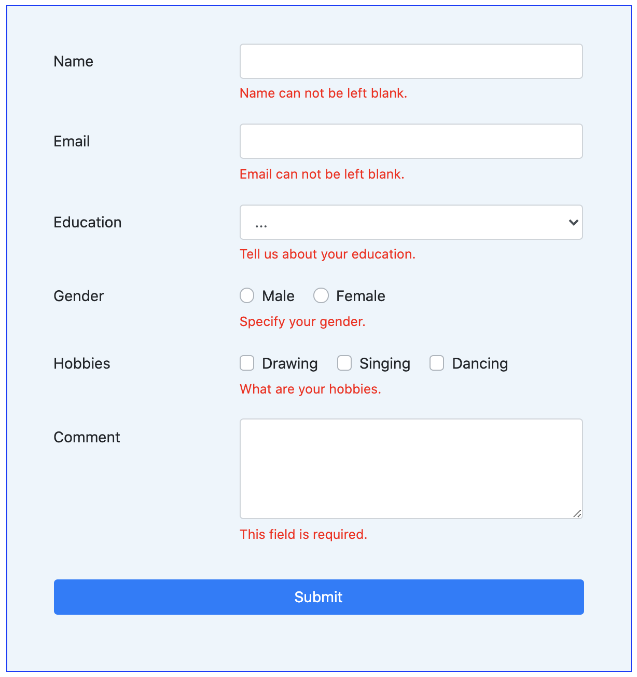
What is form validation?
Go to any popular site with a registration form, and you will notice that they provide feedback when you don't enter your data in the format they are expecting. You'll get messages such as:
"This field is required" (You can't leave this field blank).
"Please enter your phone number in the format xxx-xxxx" (A specific data format is required for it to be considered valid).
"Please enter a valid email address" (the data you entered is not in the right format).
"Your password needs to be between 8 and 30 characters long and contain one uppercase letter, one symbol, and a number." (A very specific data format is required for your data).

Slide 3
continue
This is called form validation. When you enter data, the browser or the web server will check to see that the data is in the correct format and within the constraints set by the application. Validation done in the browser is called client-side validation, while validation done in server is called server-side validation.

Slide 4
What is client side validation?
Client-side validation is an initial check and an important feature of good user experience; by catching invalid data on the client-side, the user can fix it straight away. If it gets to the server and is then rejected, a noticeable delay is caused by a round trip to the server and then back to the client-side to tell the user to fix their data.

Slide 5
Advantage of client side validation
Instant feedback: Client-side validation provides immediate feedback to users when they enter invalid data, without needing to submit the form and wait for the server response. This helps users quickly identify and correct errors, improving the overall user experience.
Reduced server load: By validating input on the client side, you can prevent unnecessary requests from being sent to the server, especially for trivial errors that can be caught locally. This helps to reduce server load and bandwidth consumption, leading to better server performance and scalability.
Improved responsiveness: With client-side validation, users can quickly correct errors without waiting for the server response, leading to a more responsive application. It enhances the perceived speed of the application and contributes to a smoother user interaction.

Slide 6
Disadvantage of client side validation
Increased development complexity: Implementing client-side validation requires additional development effort and complexity. Developers need to write and maintain the validation logic in client-side scripting languages like JavaScript, which adds complexity to the codebase.
Code duplication: Implementing validation logic on both the client and server sides can lead to code duplication. Validation rules and error messages may need to be maintained in two separate places, which can increase development time and introduce potential inconsistencies if not properly synchronized.
Limited validation capabilities: Client-side validation is typically used for basic validation checks and input formatting, such as checking required fields, email formats, or password strength. However, more complex validation rules that involve database lookups, cross-field dependencies, or business logic cannot be reliably performed on the client side alone. Server-side validation is necessary for comprehensive and robust data validation.

Slide 7
Different type of client side validation
JavaScript Validation
Built-in Form Validation

Slide 8
JavaScript validation
JavaScript validation is coded using JavaScript and is more customizable than built-in form validation. It gives you more control over the design, feel, and microcopy of your validation messages, allowing you to create forms that express your brand’s identity.
However, as you can probably guess, validating forms using JavaScript requires pretty extensive coding knowledge and stricter continuous testing processes in response to code changes.

Slide 9
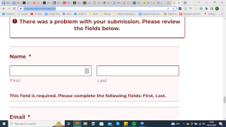
Built-in Form Validation
Built-in form validation uses HTML5 to perform data validation instead of the more traditionally-used JavaScript. It’s well-supported by popular modern browsers (Safari, Firefox, etc.) which makes it a fantastic modern form control for those who aren’t a fan of writing JavaScript code.
Its ability to independently validate user data is made possible through the use of validation attributes of the form elements. For example:
“Type”: Defines the specific type of data that should be inputted (email address, URL, phone number, etc,).
“Required”: Marks the form field as mandatory, meaning it must be filled in before submission.
“Pattern”: Dictates regular expression (pattern) rules that the inputted data needs to abide by for validation.

Slide 10
Thank you

